Slide 1


Slide 2
Elementary Economic Analysis
An industry can source its raw material from a nearby place or from a far-off place for its business.
Following factors affect the decision making of an entrepreneur:
Price of the raw material
Transportation cost of the raw material
Availability of the raw material
Quality of the raw material

Slide 3
Consider the alternative of sourcing raw materials from a nearby place with the following characteristics:
The raw material is more costly in the nearby area.
The availability of the raw material is not sufficient enough to support the operation of the industry throughout the year.
The raw material requires pre-processing before it is used in the production process. This would certainly add cost to the product.
The cost of transportation is minimal under this alternative.

Slide 4
On the other hand, consider another alternative of sourcing the raw materials from a far-off place with the following characteristics:
The raw material is less costly at the far off place.
The cost of transportation is very high.
The availability of the raw material at this site is abundant and it can support the plant throughout the year.
The raw material from this site does not require any pre-processing before using it for production.

Slide 5
EXAMPLES FOR SIMPLE ECONOMIC ANALYSIS
Material selection for a product
Design selection for a product
Design selection for a process industry
Building material selection for construction activities
Process planning/Process modification

Slide 6
Material Selection for a Product/ Substitution of Raw Material
Among various elements of cost, raw material cost is most significant and it forms a major portion of the total cost of any product.
So, any attempt to find a suitable raw material will bring a reduction in the total cost in any one or combinations of the following ways:
Cheaper raw material price
Reduced machining/process time
Enhanced durability of the product

Slide 7
Example 1
In the design of a jet engine part, the designer has a choice of specifying either an aluminum alloy casting or a steel casting. Either material will provide equal service, but the aluminum casting will weigh 1.2 kg as compared with 1.35 kg for the steel casting. The aluminum can be cast for Rs. 80.00 per kg. and the steel one for Rs. 35.00 per kg. The cost of machining per unit is Rs. 150.00 for aluminum and Rs. 170.00 for steel. Every kilogram of excess weight is associated with a penalty of Rs. 1,300 due to increased fuel consumption. Which material should be specified and what is the economic advantage of the selection per unit?

Slide 8
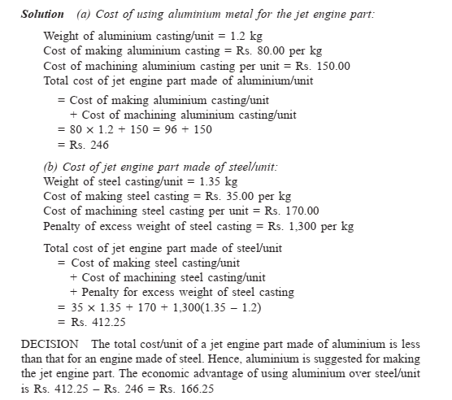

Slide 9
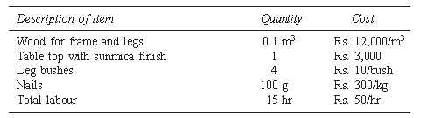
Example 2
A company manufactures dining tables which mainly consist of a wooden frame and a table top. The different materials used to manufacture the tables and their costs are given in Table 1
Table 2: Wooden Table Top

Slide 10
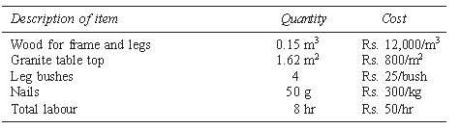
Table 2: Granite Table Top

Slide 11
Cont.
If the cost of the dining table with a granite top works out to be lesser than that of the table with wooden top, the company is willing to manufacture dining tables with granite tops. Compute the cost of manufacture of the table under each of the alternatives described above and suggest the best alternative.
Also, find the economic advantage of the best alternative.

Slide 12
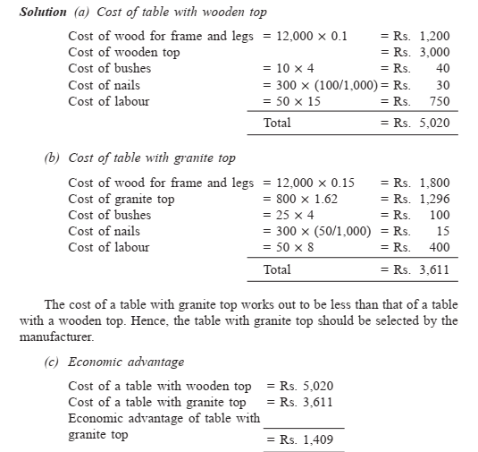

Slide 13
Design Selection for a Product
The design modification of a product may result in reduced raw material requirements, increased machinability of the materials and reduced labour.
Design is an important factor which decides the cost of the product for a specified level of performance of that product.

Slide 14
Example 1
Two alternatives are under consideration for a tapered fastening pin. Either design will serve the purpose and will involve the same material and manufacturing cost except for the lathe and grinder operations. Design A will require 16 hours of lathe time and 4.5 hours of grinder time per 1,000 units. Design B will require 7 hours of lathe time and 12 hours of grinder time per 1,000 units. The operating cost of the lathe including labour is Rs. 200 per hour. The operating cost of the grinder including labour is Rs. 150 per hour. Which design should be adopted if 1,00,000 units are required per year and what is the economic advantage of the best alternative?

Slide 15
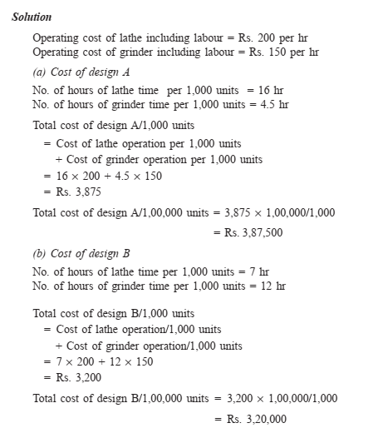

Slide 16
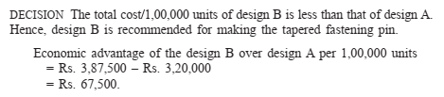

Slide 17
EXAMPLE 2 (Design selection for a process industry).
The chief engineer of refinery operations is not satisfied with the preliminary design for storage tanks to be used as part of a plant expansion programme. The engineer who submitted the design was called in and asked to reconsider the overall dimensions in the light of an article in the Chemical Engineer, entitled “How to size future process vessels?” The original design submitted called for 4 tanks 5.2 m in diameter and 7 m in height. From a graph of the article, the engineer found that the present ratio of height to diameter of 1.35 is 111% of the minimum cost and that the minimum cost for a tank was when the ratio of height to diameter was 4 : 1. The cost for the tank design as originally submitted was estimated to be Rs. 9,00,000. What are the optimum tank dimensions if the volume remains the same as for the original design? What total savings may be expected through the redesign?

Slide 18
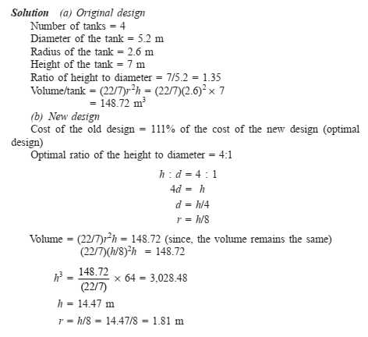

Slide 19
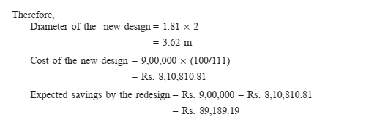

Slide 20
Building Material Selection
The sourcing of raw materials will have a significant effect on the cost of any product. Hence, it is assumed that the price of raw material is location dependent. While sourcing a raw material, the cost of transportation is to be considered in conjunction with the price of the raw material.

Slide 21
EXAMPLE
In the design of buildings to be constructed in Alpha State, the designer is considering the type of window frame to specify. Either steel or aluminium window frames will satisfy the design criteria. Because of the remote location of the building site and lack of building materials in Alpha State, the window frames will be purchased in Beta State and transported for a distance of 2,500 km to the site. The price of window frames of the type required is Rs. 1,000 each for steel frames and Rs. 1,500 each for aluminium frames. The weight of steel window frames is 75 kg each and that of aluminium window frame is 28 kg each. The shipping rate is Re 1 per kg per 100 km. Which design should be specified and what is the economic advantage of the selection?

Slide 22
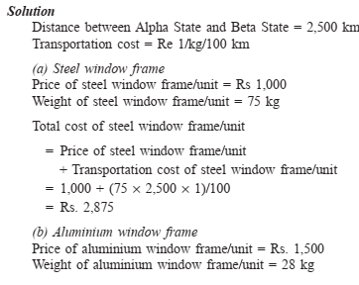

Slide 23
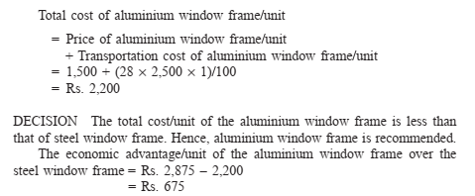

Slide 24
Process Planning /Process Modification
While planning for a new component, a feasible sequence of operations with the least cost of processing is to be considered. The process sequence of a component which has been planned in the past is not static. It is always subject to modification with a view to minimize the cost of manufacturing the component.
So, the objective of process planning/process modification is to identify the most economical sequence of operations to produce a component.

Slide 25
The steps in process planning are as follows:
Analyze the part drawing to get an overall picture of what is required.
Make recommendations to or consult with product engineers on product design changes.
List the basic operations required to produce the part to the drawing or specifications.
Determine the most practical and economical manufacturing method and the form or tooling required for each operation.
Devise the best way to combine the operations and put them in sequence.
Specify the gauging required for the process.

Slide 26
Example 1
The process planning engineer of a firm listed the sequences of operations as shown in following table produce a component.
Sequence | Process sequence
1 | Turning – Milling – Shaping – Drilling
2 | Turning – Milling – Drilling
3 | All operations are performed with CNC machine

Slide 27
The details of processing times of the component for various operations and their machine hour rates are summarized in
Find the most economical sequence of operations to manufacture the component?
Operation | Machine hour rate | Process sequence (in minutes)
 |  | 1 | 2 | 3
Turning | 200 | 5 | 5 | -
Milling | 400 | 8 | 14 | -
Shaping | 350 | 10 | - | -
Drilling | 300 | 3 | 3 | -
CNC Operations | 1000 | - | - | 8

Slide 28
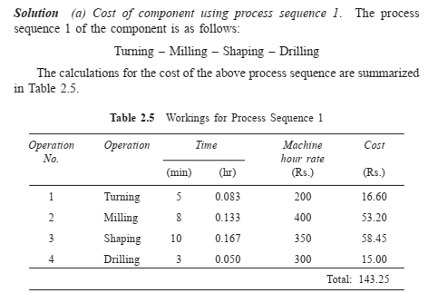

Slide 29
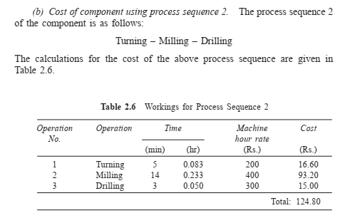

Slide 30
